Slide 1
Sustainable Agriculture Practices
Innovative technologies for climate change mitigation by Mediterranean agricultural sector– Clima MED
LIFE17 CCM/GR/000087
https://life-climamed.eu/home

Slide 2
Problems and Challenges in Agriculture Sector
Food production is estimated to increase by 50% until 2050
828 million people in the world are hungry (~10%)
The expansion of agricultural land without destroying the environment is very limited. Agriculture accounts for 90% of forest destruction
About 40% of agricultural land has been degraded due to intensive agriculture
⅓ of agricultural production ends up in landfills, further degrading the environment

Slide 3
Problems and challenges
Agriculture is responsible for about 70% of human freshwater consumption
Livestock and agriculture production are major sources of methane, nitrous oxide and toxic chemical emissions
Agriculture is the leading cause of biodiversity loss, posing a threat to 24,000 of the 28,000 (86%) species at risk of extinction
Agriculture depends to a significant extent on the use of non-renewable resources such as phosphorus and potassium fertilizers.
Chemical pollution from excessive use of fertilizers and pesticides affects biodiversity, water and soil quality

Slide 4
What is Sustainable Agriculture?
Sustainable = Sustain + Able
The ability to practice farming and sustain adequate crop production to meet the demands for food and fibers, without requiring for the next generations to compromise
To be achieved it requires to:
Understand the principles of ecology
Study the relationship between organisms and environment

Slide 5
Sustainability Goals in Agriculture
Environmental pillar: The goal of Sustainable Agriculture is to reduce the environmental burden of farming, safeguard the natural resources, and increase crop productivity. The practice of sustainable practices take into consideration the environmental, economic, and social aspects of agriculture.
Environmental Benefits: Crop production through efficient use of resources and integrated approaches that minimize negative environmental impacts
Preservation of Water Resources,
Avoid the degradation of soils,
Reduces toxic impact in the environment and prevent pollution,
Enhances flora and fauna biodiversity.

Slide 6
Sustainability Goals in Agriculture
Social Pillar: Protection of public health since the use of hazardous chemicals is minimized. Ensure safe fair working conditions for all workers. Promote food security by producing adequate amount of healthy crops and livestock.
Economic Pillar: Provide affordable access to good food for all and sufficient income to farmers and workers related to the industry

Slide 7
The principles of Sustainable Agriculture
Long-term vision rather than focusing in a short-term profit
Maintain biodiversity of land (flora / fauna)
Keep records for each crop area to help make the best decision environmentally and economically
Use of renewable energy resources (solar, wind, biomass)
Safe disposal of hazardous waste (chemical fertilizers)
Optimize productivity

Slide 8
Sustainable Practices
Integrated Pest Management (IPM)
Conservation or no-tillage
Integrated crop – livestock system
Crop Rotation
Cover crops
Intercropping
Agroforestry

Slide 9
Integrated Pest Management (IPM)
Integrated Pest Management an approach that use mechanical and biological control measures to minimize the use of synthetic pesticides. Knowledge of the ecology and interactions between plants and pests is fundamental to implementing techniques to discourage the development of pest population.
An integrated approach in monitoring and prevention actions precedes any further intervention. Chemical pesticides are only applied as a last resort when they exceed the crop’s economic threshold, beyond which the damage of pest and diseases on crop production is higher than the cost of application.

Slide 10
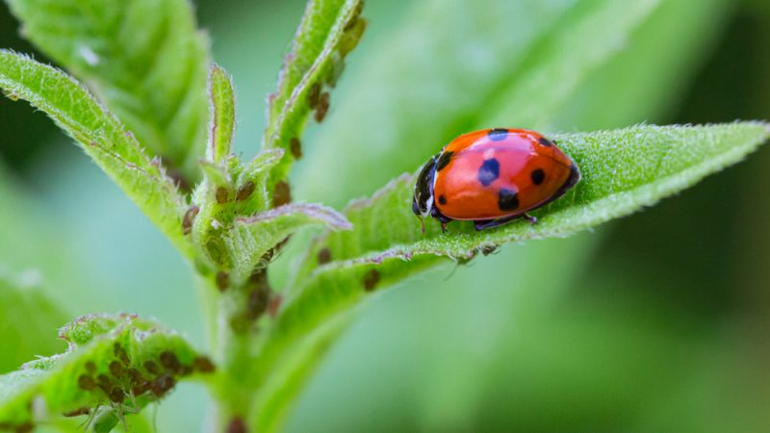
Integrated Pest Management (IPM)
Prevention measures include:
Cultivation of resistant/ tolerant varieties
Balanced nutrient and irrigation applications
Hygiene measures to avoid spreading the diseases
Choice of planting dates and distances
Plant only certified planting material, free from pest and diseases
Weed control
Use of plant traps
Crop rotation

Slide 11
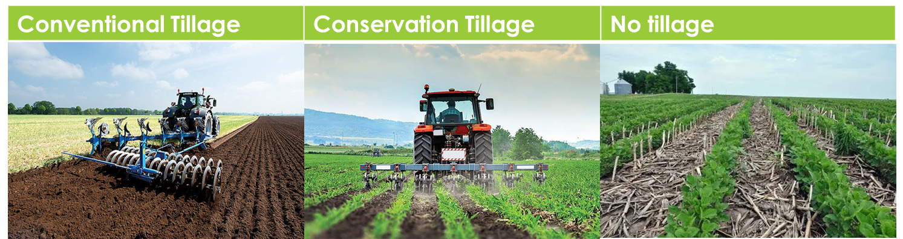
Reduced or no-tillage
The practice of minimizing or eliminating soil distribution, maintaining the natural soil structure. Crop residues and stable remain and soil compaction from heavy machineries is avoided.
The moisture and reduced temperature on the soil surface favors the biodiversity of insects. It has also the benefits of reduced erosion and the possibility to sequester carbon.
Reduced tillage is especially important for Mediterranean region, where soil erosion due to heavy rains is observed. In the event of reduced precipitation, no-tillage or reduced tillage can be beneficial for the plant physiology, but proper weed management is required to minimize competition among plants

Slide 12
Reduced or no-tillage
 | Conventional Tillage | Reduced Tillage | No tillage
Practice | Extensive mechanical disturbance of the soil using tools like plows, harrows, and cultivators. | Minimal mechanical disturbance of the soil. Only a narrow strip where seeds will be planted is tilled | The soil is left largely undisturbed, with no tilling or plowing.
Residue Management | Crop residues are often mixed into the soil or buried | Crop residues remain on the soil surface, acting as a mulch | Residues remain entirely on the soil surface
Erosion control | Very high wind and water erosion | Reduced risk of wind and water erosion | Reduced risk of wind and water erosion
Soil Organic Matter | Low due to oxidization of organic matter | Build-up of Soil Organic Matter | Build-up of Soil Organic Matter
Soil Health | Very poor | Comparatively good | Good, promotes microbial activity
Weeds | Controls weeds but also bring weed seed on the surface, promoting germination | Crop residues can suppress weed growth | Crop residues can suppress weed growth
Labor and Cost | High use of diesel and time effort | Diesel use and labor is reduced | No diesel required
The practice of minimizing or eliminating soil distribution, maintaining the natural soil structure.
Crop residues and stable remain and soil compaction from heavy machineries is avoided.
The moisture and reduced temperature on the soil surface favors the biodiversity of insects. It has also the benefits of reduced erosion and the possibility to sequester carbon.

Slide 13
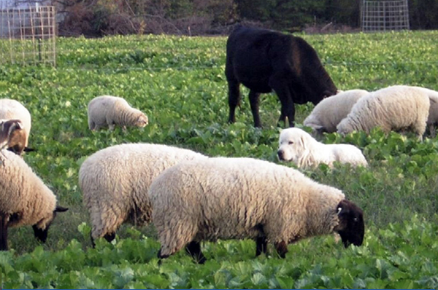
Integrated crop – livestock system
The agricultural practice that combine crop and livestock production within the same farming operation. The interaction and integration between crops and livestock create a symbiotic relationship maximizing the benefits for both components.
Crop residues or cover crops are used as livestock feed and the manure from livestock production can be used as organic fertilizer in the cropping system. By that, the use of fertilizer input is reduces, soil erosion is prevented, soil organic C content and water retention increases. Overall, the resilience of the system in weather anomalies is enhanced.
Farming operations and cost is greatly reduces as the system
works almost independently. The cost of inputs decreases and
the diversified system reduces the risk of raising a single product.

Slide 14
Examples
System | Tree Component | Crop | Animal
Grazed orchards | Apple | Perennial ryegrass | Sheep
Grazing walnut timber plantations | Hybrid walnut (Juglans major x regia) | Grass species | Sheep
Chestnut agroforestry | Chestnut (Castanea sativa L.) | Ulex sp., Pteridiumsp. Rubus sp., and mushrooms | Pigs
Intercropping of olive groves | Olive (Olea europea) | Cereals, maize, grape vines, vegetables, grass, and chickpea | Sheep

Slide 15
Crop Rotation
Rotating crops is the practice of planting different crops (originating from distinguished botanical family groups) sequentially in the same plot.
Crop rotations can be from 3 to 7 years.
The main benefits of this practice is that maintains soil fertility, keeps the harmful pest and diseases populations in low levels and provides diversified income to the farmer.
The different crops have differences in root development, nutrient requirements and pest and diseases. The prevalence of pest and diseases is greatly reduced as they remain without a host for several years.

Slide 16
Crop Rotation Examples
1st Year | 2nd Year | 3rd Year | 4th Year
Potato | Winter barley | Onion | Vetch
Watermelon | Winter wheat | Beetroot
Winter barley | Carrot | Eggplant | Spinach
Cabbage | Onion | Potato | Beans
It is important that successive crops belong to different botanical families with different root systems and nutrient requirements

Slide 17
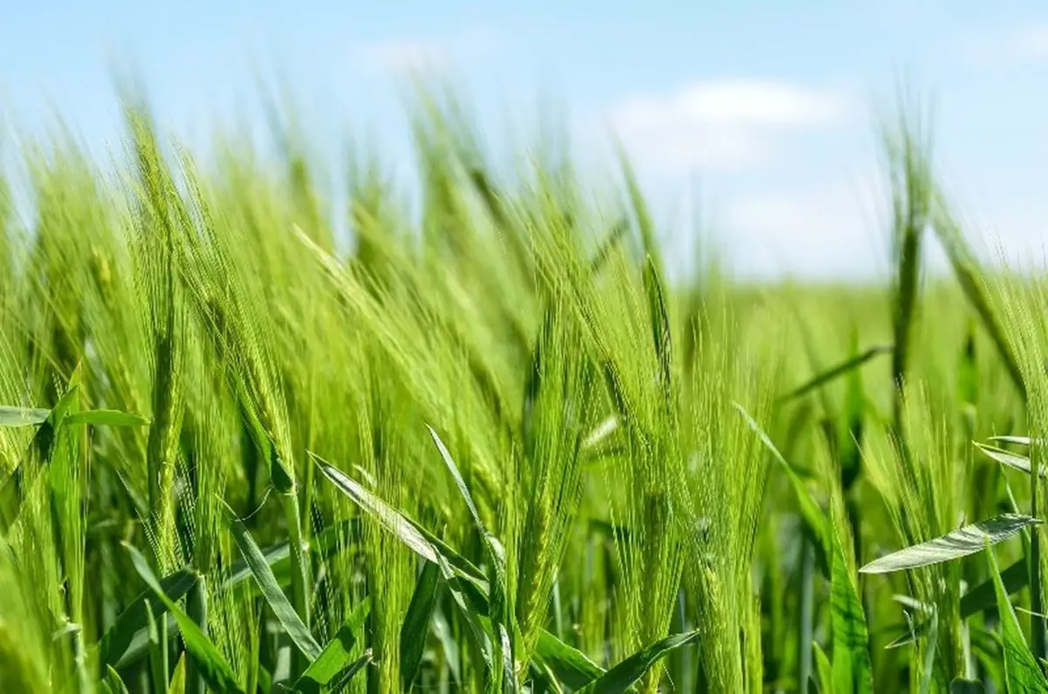
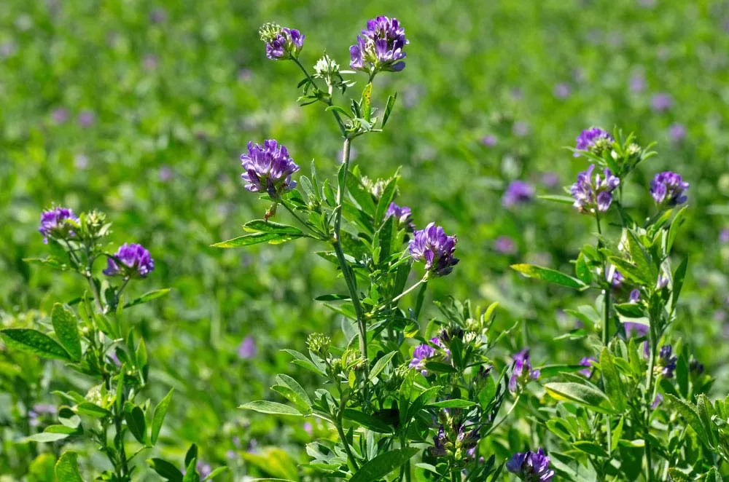
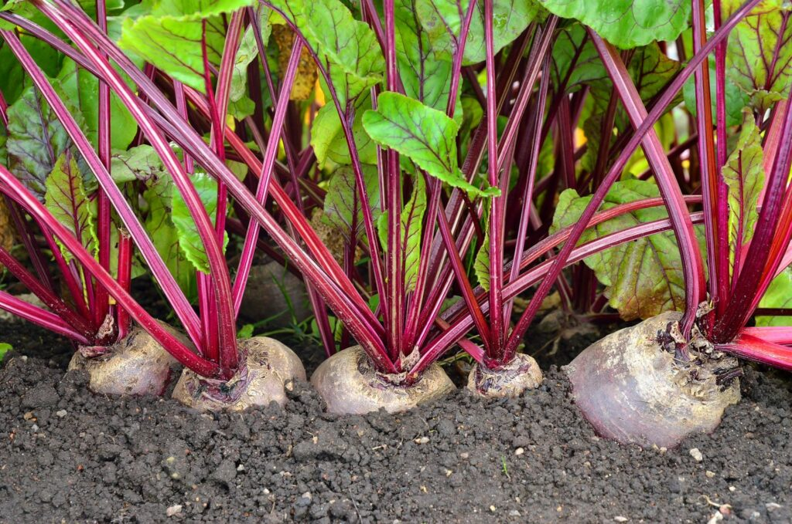
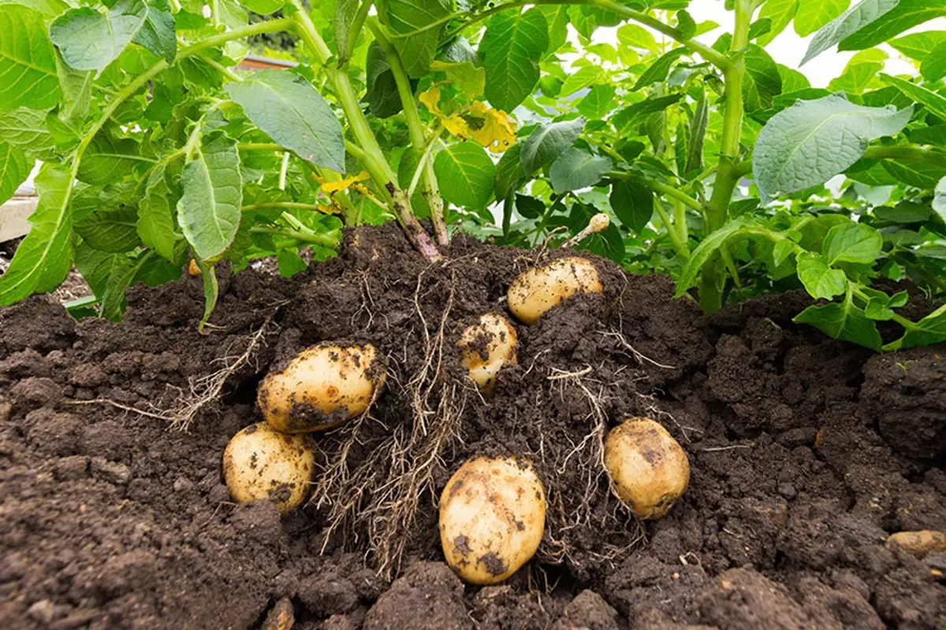
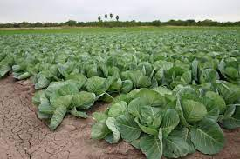
Crop Rotation
Field 1 - Barley
Field 2 - Beetroot
Field 5 –
vetch
Field 4 –
Potato
Field 3 –
Cabbage

Slide 18
Cover Crops
Planting cover crops, such as legumes or grasses, during fallow periods helps protect the soil from erosion, improves soil fertility, suppresses weeds, and enhances water retention. Cover crops also contribute organic matter to the soil when they are incorporated.
Examples of cover crops:
Grasses (wheat, oats, triticale, barley, sorghum, ryegrass, corn)
They can grow successfully in many different climates, relatively fast and leave large amounts of residues that add to soil organic matter. They prevent soil erosion, suppress weed growth and scavenge nutrients from previous crops, especially nitrogen.

Slide 19
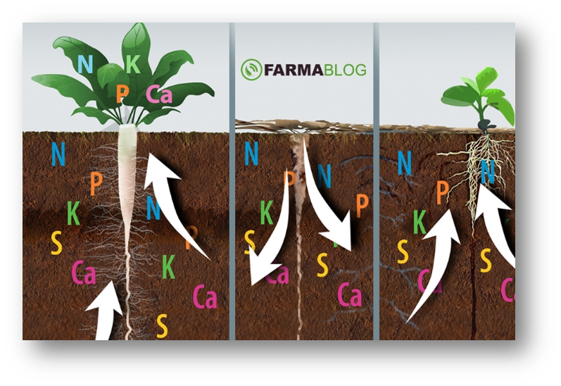
Cover Crops
Legumes (hairy vetch, cowpea, pea, alfalfa, fava, red and white clover, lablab)
Legumes are popular as nitrogen-fixing crops. Their strong root system can improve soil structure and prevent soil erosion. The bigger the plants grow, the more benefits they provide. Compared to grasses, they are lower in carbon and higher in N content that is usually released faster. Also they attract more insects
Broadleaf non-legumes (radishes, mustard, rapeseed)
Apart from the benefits in weed management, soil erosion
prevention and tackling soil compaction,
Brassicaceae family has bio-fumigation abilities.
The release of toxic compounds as they break down
decreases sol borne pathogens and pests, such as nematodes,
fungi and some weeds.

Slide 20
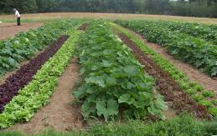
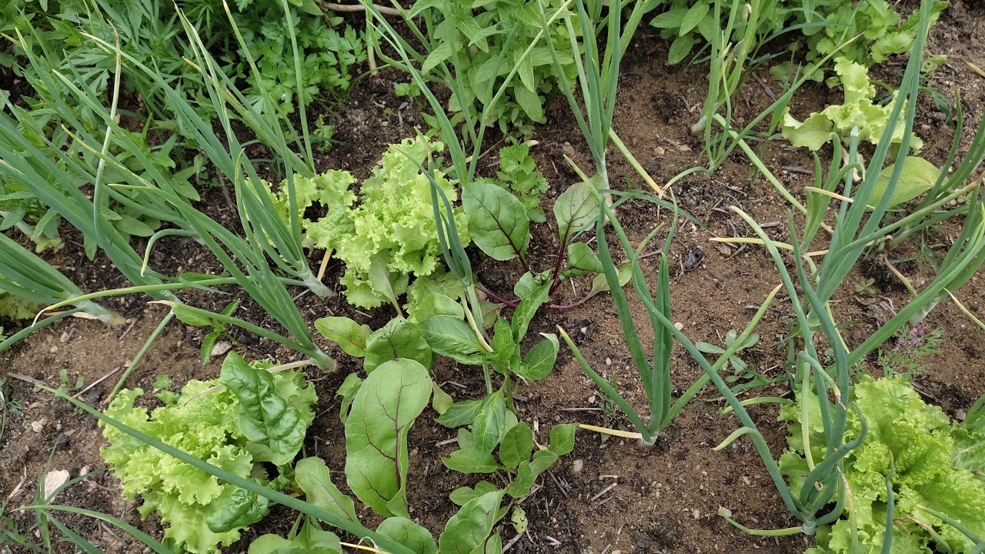
Intercropping
Intercropping is the practice of growing simultaneously two or more crops in the same plot of land for a significant part of their growing cycle.
Farmers must take into consideration nutrient, light, water, growing cycles and density when choosing the appropriate plants and type of intercropping.
Evidence show that this practice is very effective against suppressing the most persistence weeds. Some crop combinations may also have positive allelopathic properties or synergistic effect boosting productivity and crop efficiency.
Secondary crops may have the ability to trap or repel harmful pest and attract beneficial ones, reducing the need for chemical spraying. Cultures also improve soil fertility, reducing their reliance in fertilizer applications and making efficient use of natural resources (water, light etc.).

Slide 21
Intercropping
There are several types of intercropping:
Row Cropping: The most popular option where farmers plant in rows. A combination of cereals and legumes is proven to be beneficial
Strip Intercropping: Similar to row cropping, but rows are much wider to facilitate machine operations
Relay Cropping: The secondary crop is planted after the primary has flowered. E.g. Cotton and corn
Temporal Intercropping: The two crops have different maturing time

Slide 22
Intercropping
Trap Cropping: The secondary crop acts like a pest trap to protect the main crop, thus reducing spraying
Repellant Intercropping: Secondary crop serves as pest-repellant
Push-pull cropping: Combines both trap and repellant crops
Alley Cropping
Mixed Intercropping

Slide 23
Intercropping examples
System | Crops
Row Intercropping | Vicia sativa - Barley
Alley Intercropping | Mandarins – broad beans (Sep-Jan) and barley with Vicia sativa in a 3:1 ratio (Jan-Jun)
Row Intercropping | Forage pea - barley
Alley Intercropping | Orange - Chickpea
Row Intercropping | Cabbage - Onion
Relay Intercropping | Maize - Sweet potato
Repellant Intercropping | Grapes - tobacco

Slide 24
Agroforestry
Agroforestry is the integration of perennial trees, livestock and crops the same piece of land.
The main benefits of this practice are improved soil fertility, carbon sequestration, diversified income and shade for crops. Trees may provide valuable wood, softwood for fiber production and/or sellable fruits and nuts.
There are three main agroforestry systems:
1. Agri-Silviculture (Alley Cropping):
The practice of trees and crop production in the same piece of land, planted in alternate rows. Microclimate benefits can help farmer manage risks, as trees influence light, wind, water and nutrient status.

Slide 25
Agroforestry
2. Silvopasture
The combination of trees, forage and grazing livestock. The systems are managed for both livestock production, forage and forest products. The principle is providing ‘free’ organic matter for the soil and shade for livestock and grazing. Shade reduces animal stress and prolong grazing period.
3. Forest Farming
The intentional cultivation of medicinal, decorative or edible specialty crops under the canopy of the trees. The native or planted woodlands are manage to provide optimal conditions for the high-value crop and for wood production.

Slide 26
Organic farming
Organic farming is an agricultural system that uses a combination of mechanical and biological methods with the main principle to avoid the use of synthetic fertilizers, pesticides and genetically modified organisms. Instead, organic fertilizers, compost and beneficial insects or microorganisms are used. The aforementioned practices are included in organic farming but with the exclusion of chemicals.
Crops produced are healthier and more nutritious than conventional farming. Selling price per unit is also higher, because of the low productivity and increased labor cost in organic farming.
The main benefits of organic farming is the (i) environmental protection, (ii) biodiversity enhancement, (iii) soil protection, (iv) reduced greenhouse gasses emissions, (v) higher profitability and (vi) the development of local communities.

Slide 27
Precision Farming
Precision farming is a high-tech farm management approach that utilizes a combination of available technologies to collect and analyze all the information about the crop. The aim is to optimize resource use, reduce cost, increase crop yield and animal performance through facilitating decision making. Additionally, the environmental burden from agriculture is significantly reduced.
Technologies are used for real-time observations, measurements and responding to temporal and spatial variability in crops. The precision farming technology operates in three levels;
ground
aerial
satellite

Slide 28
Precision Farming
Remote Sensing
Remote sensing collect data from a distance using satellites, drones and aerial imagery. The basic role of remote sensing is observation and monitor of the crop health, pest infestation, soil and water conditions. The information assist the farmer to make informed decisions about irrigation, fertilization, planting date and pest infestation.
Variable Rate Application (VAR) equipment
VRA systems have the possibility to apply the exact quantity of fertilizer, seed or pesticide required where and when it’s needed. VAR system works based on data collected from GPS, maps and sensors.
Autonomous Vehicles
Autonomous vehicles enables the use of smaller machinery which can prevent soil compaction and be more precise with the inputs. There is also the possibility of decarbonization with the use of renewable energy.

Slide 29
Precision Farming
Global Positioning System (GPS)
The most important uses of GPS in agriculture include soil sampling, yield maps, field mapping, crop scouting, machinery control, irrigation systems and land micromanage
Geographic Information System (GIS)
GIS can be used to create soil maps, crop health and topography. It facilitates the visualization of complex data and for spatial analysis. The difference between GIS and GPS is that GIS is used to record information on maps and GPS to track the exact location of things.

